Slide 1
Tableau - Sales Data Dashboard and Story - WorkbookFile
File created on: 1/9/2019 2:32:19 PM

Slide 2
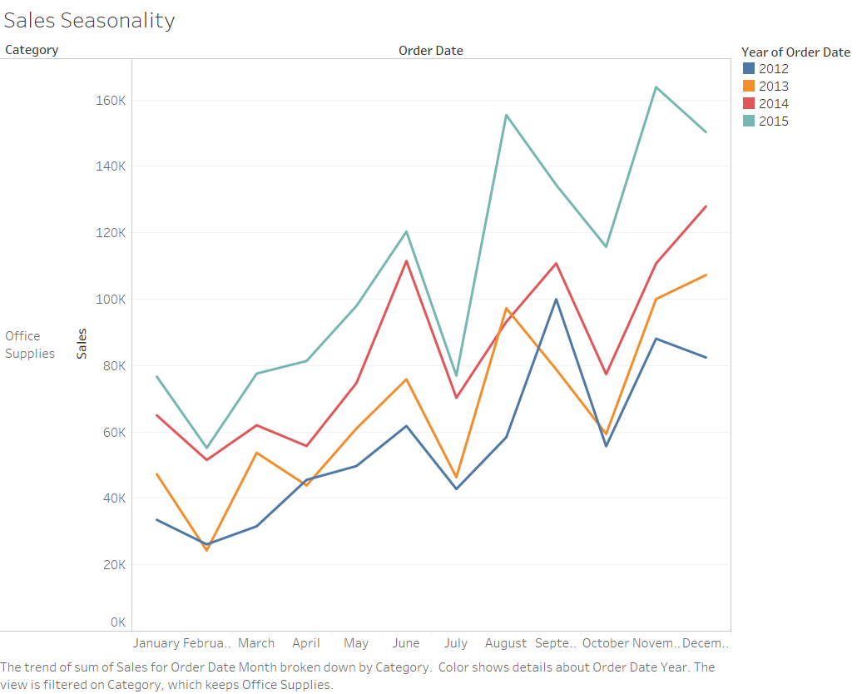

Slide 3
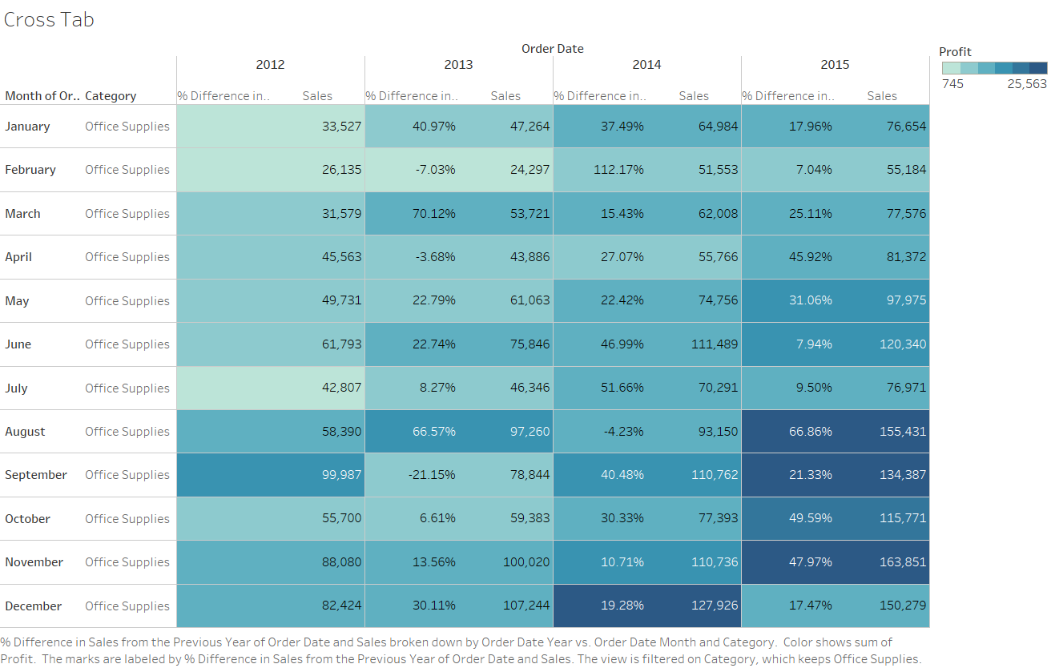

Slide 4
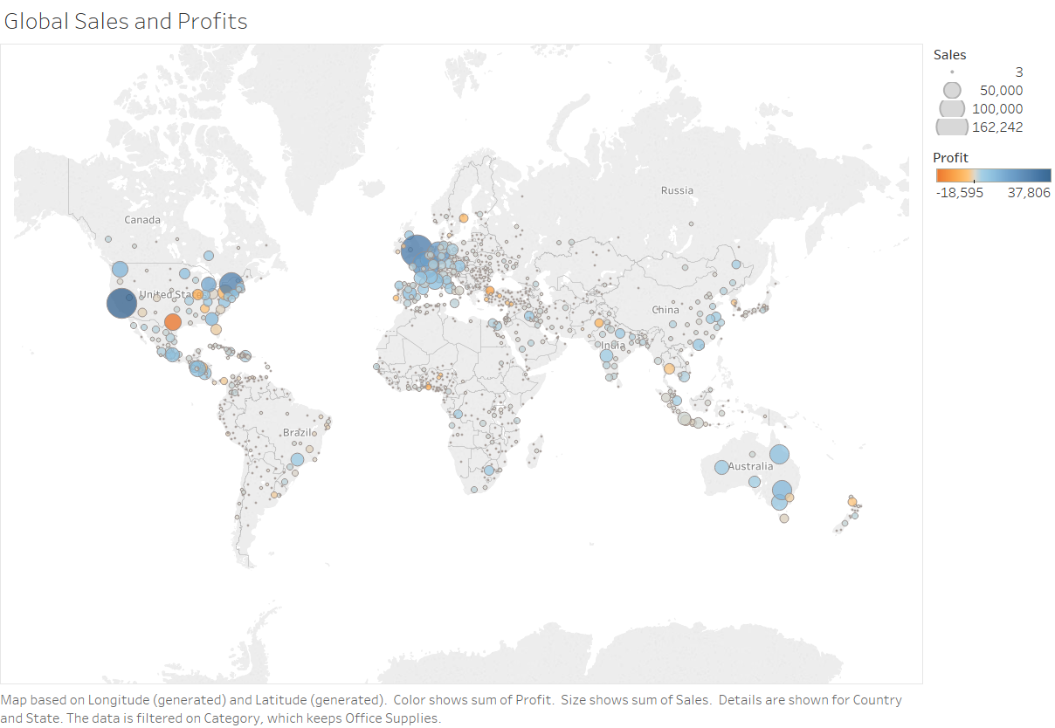

Slide 5
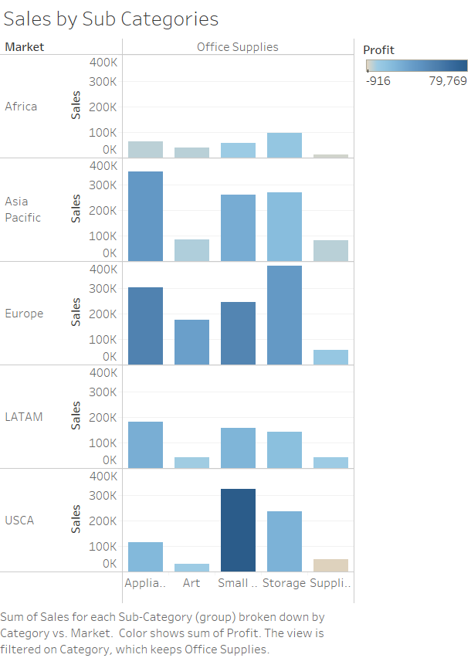

Slide 6
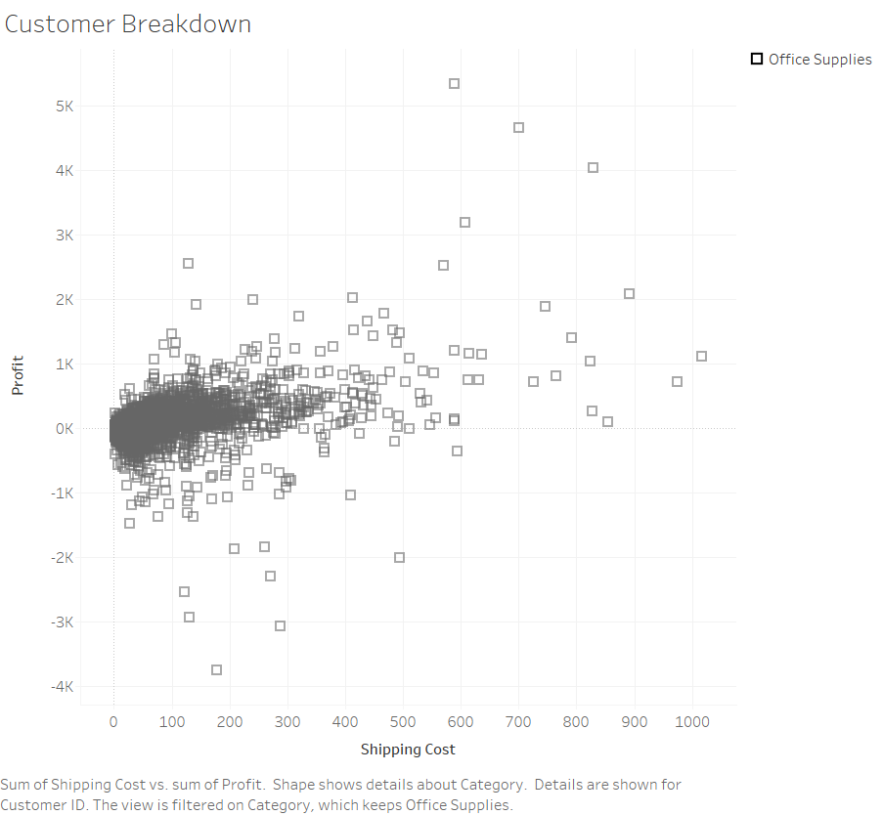

Slide 7
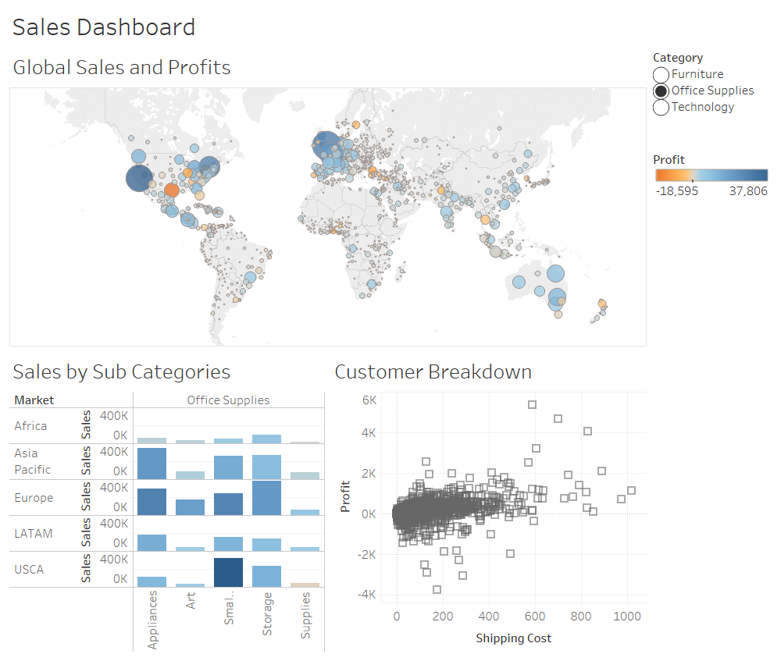

Slide 8
